Slide 1
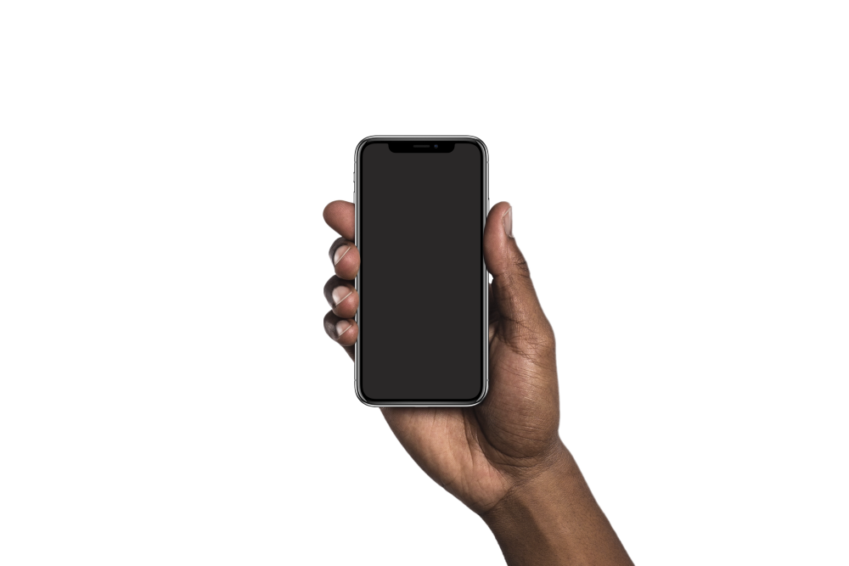

HEALTHYU
A care coordination app
HEALTHY
We’re making your personal care our personal problem.
Good Morning, Tyrell!
You have a radiology appointment today at 10:00AM. Click for more details.
CREATED BY DEBORAH OJUMU

